Slide 1
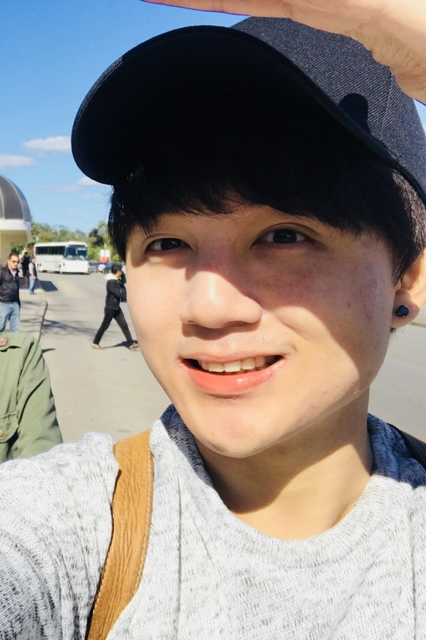


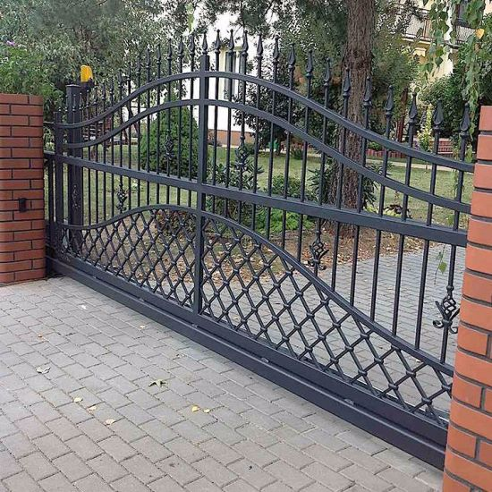
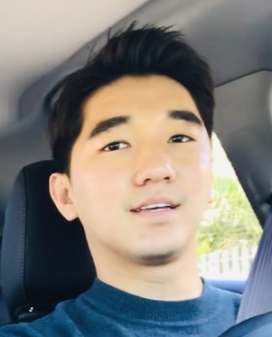
Database
Face verification
Hi, I am “Sean”
Sean
Gia
Access granted!
Hi, I am “Jason”
Hi, I am “Gia”
Access denied!
Hi, I am “Sean”

Slide 2
Database
Face recognition
Sean
Gia
Access granted.
Welcome “Sean”!
Access denied.
Not registered face!

Slide 3

Image embedding and similarity function
Database
Image_1
CNN
Sean
N-d vector
d(image_1,image_2)
New image
N-d vector
<= 𝞃 → same!
> 𝞃 → different!
Image_2
CNN

